Slide 1

Note: The data and information in this document is reflective of a hypothetical situation and client. This document is to be used for KPMG Virtual Internship purposes only.
Sprocket Central Pty Ltd
Data analytics approach
Aakash Karri

Slide 2
Agenda
Introduction
Data Exploration
Model Development
Interpretation

Slide 3
Introduction
Identify & Recommending High Value Customer
Outline Of Problem
Sprocket central is A company that specialize in high-quality bike and accessories.
The marketing team is looking to boost sales.
To target 1000 new customer that will bring the highest value to the business.
Approach for data analysis
Bike Related purchases for the last 3 years based on gender
Top industries contributing the maximum profit and bike related sales
Wealth segment by age category
Number of cars owned in each state

Slide 4
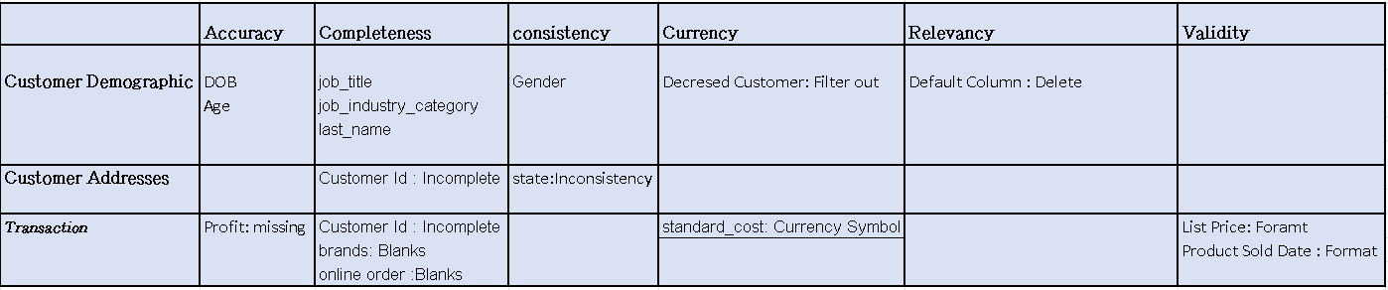
Data Exploration
Data Quality Assessment
Key issue dealt with for the data quality issue:

Slide 5
Data Exploration
Bike Related Purchases For The Last 3 Years Based On Gender
Data shows, on average male have made more bike related purchases in the last 3 years compared to males
On average male have had 1% higher bike related purchases compared to female in last 3 years

Slide 6
Data Exploration
Top Industries Contributing The Maximum Profit And Bike Related Sales
The top 3 industry sector bringing in the highest profit are: financial services, health & manufacturing
These can be obvious as most of these industry sectors are based within the city or on the outskirts of the city therefore consumers prefer bikes for commuting
Most of the industry sectors have returned less than $1,000,000 in profits

Slide 7
Data Exploration
Wealth Segment By Age Category
Overall, the mass customer segmentation the highest profit across the different age clusters.
Mass customer aged between 41-50 are likely to bring more profit for the company compared to other age clusters.
This also indicates a trend of buying power, as the buying power increase over time till 50 and then see’s a decline in buying power, thus leading to lower profits

Slide 8
Data Exploration
Number Of Cars Owned In Each State
NSW & VIC could be potential market opportunities for the company.
NSW , has the highest potential as the number of people that own car is almost equal to the people who don’t own cars which shows that there is opportunity to find value customers there.

Slide 9
Model Development
Customer Classification – Targeting High Value Customer
These are the high value customers that should be targeted from the new list:
most of the high value customer will be male compared to female
Working in the financial services, health and manufacturing industry sector.
Mass customer in the wealth segment
Aged between 41-50
Who are currently living in NSW, VIC.

Slide 10
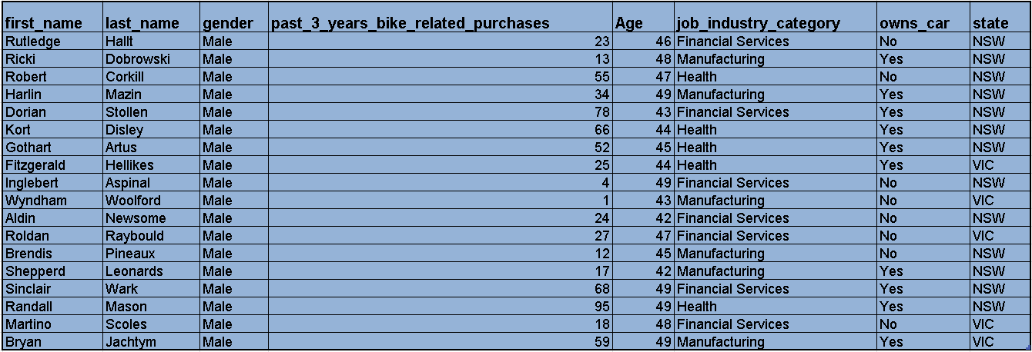
Interpretation
Summary table for high value customers
Here is a snapshot of a few customer that will come under the high value customer classification .

Slide 11
Note: The data and information in this document is reflective of a hypothetical situation and client. This document is to be used for KPMG Virtual Internship purposes only.
Thank You

